Slide 1
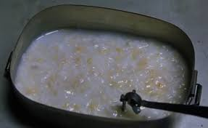
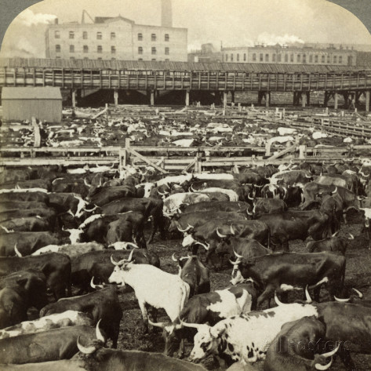
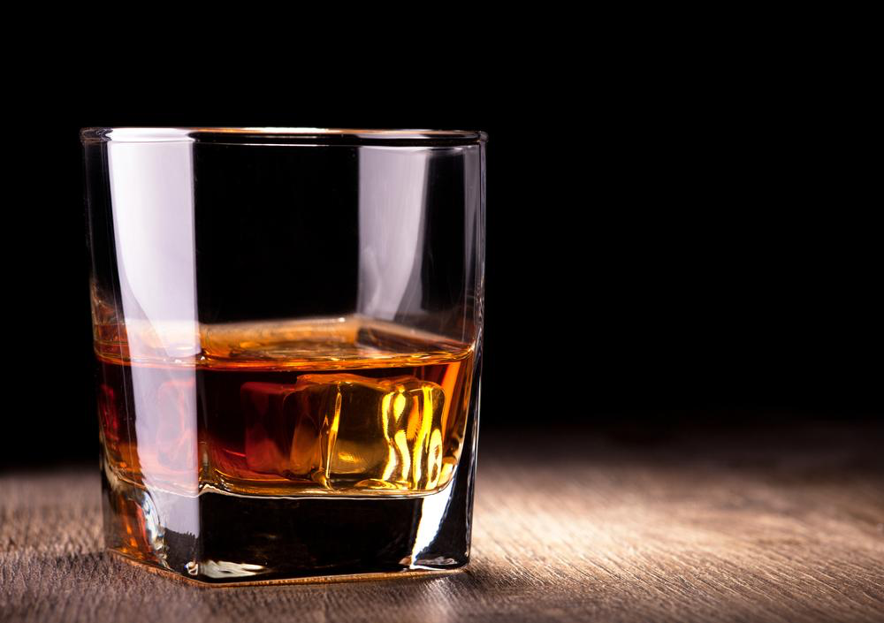
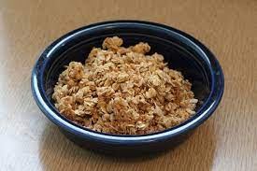
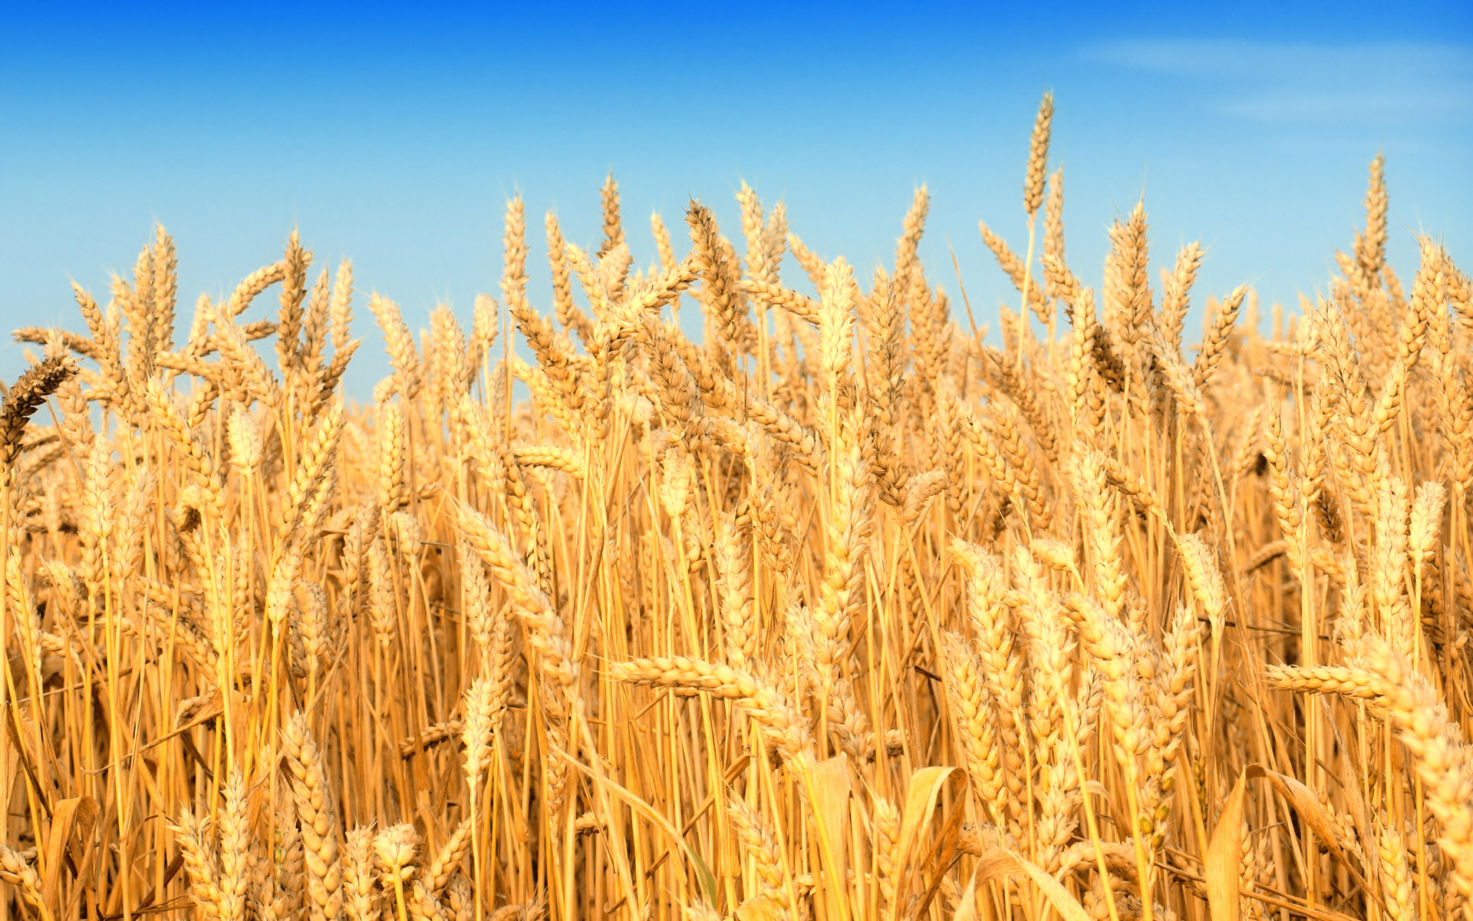
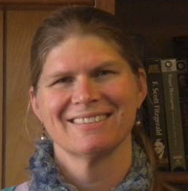
DEPARTMENT OF ENGLISH AND TECHNICAL COMMUNICATION
Food Studies, the Environment, and 19th-Century U.S. Literature
Research Topics
Imagining Tomorrow’s Bread
How futuristic narratives imagine consumption
Apocalyptic, Utopic
Key authors: Margaret Atwood, Octavia E. Butler, Louise Erdrich
Henry David Thoreau and pedagogy
Remediation project in chapter in Thoreau and the Nick of Time (forthcoming from Mercer Press)
Mark Twain and ecocriticism
In The Gilded Age
Presenting to Center for Mark Twain Studies in Elmira NY
Food and Culture in U.S. Literature
Contact Information
Kathryn Dolan
Associate Professor
Department of English and Technical
Communication
dolankc@mst.edu
573-341-4681
Keywords
Food Studies, Ecocriticism, Globalization, U.S. Literature
Significant Achievements
Cattle Country (Nebraska 2021; At Table Series)
Breakfast Cereal: A Global History (Reaktion/Chicago 2023) translated into Arabic, Chinese, Japanese
“Agriculture in US Literature” in A Companion to American Agricultural History (Wiley 2022) selected as a best historical materials of 2022 from American Library Assoc committee on best historical materials

